Slide 1

Corona Virus Analysis with SQL
By
Keerthana K R
Data Analyst Intern in Mentorness
Batch - MIP-DA-07

Slide 2
Table of Contents
Introduction
Dataset overview
Dataset Explanation
Exploratory Data Analysis using SQL
Conclusion

Slide 3
Introduction
The COVID-19 pandemic, caused by the novel coronavirus SARS-CoV-2, has swept across the globe, posing significant challenges to public health systems and societies worldwide. Since its emergence in late 2019, COVID-19 has led to millions of confirmed cases and significant loss of life, making it one of the most pressing public health crises in recent history. As a data analyst, this presentation aims to analyze a COVID-19 dataset to derive meaningful insights into the spread and impact of the virus, leveraging data-driven approaches to better understand and combat the pandemic.

Slide 4
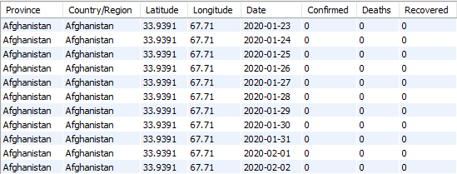
Dataset Overview

Slide 5
Dataset Explanation
Description of each column in dataset:
Province: Geographic subdivision within a country/region.
Country/Region: Geographic entity where data is recorded.
Latitude: North-south position on Earth's surface.
Longitude: East-west position on Earth's surface.
Date: Recorded date of CORONA VIRUS data.
Confirmed: Number of diagnosed CORONA VIRUS cases.
Deaths: Number of CORONA VIRUS related deaths.
Recovered: Number of recovered CORONA VIRUS cases.

Slide 6
Exploratory Data Analysis using SQL
Diving deep into the Covid-19 Dataset to uncover hidden insights and trends that can inform public health decision-making

Slide 7
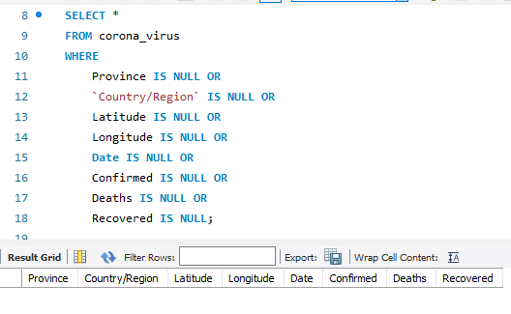
Checking null values
SQL Query
OUTPUT

Slide 8
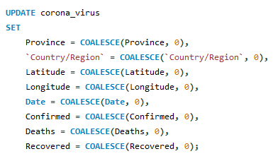
Updating null values
Inference : No null values present in any columns in dataset

Slide 9
Total Number of Rows
78386
Inference : total number records present in the table/dataset is
78386 rows.

Slide 10

Start Date And End Date
Start_date | end_date
2020-01-22 | 2021-06-13
Inference : According to dataset, the start date of pandemic is recorded as January 22,2020 and end date is June 13,2021.

Slide 11
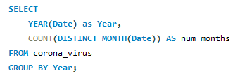

Number of Months
Inference : The number of months recorded in dataset is, in 2020 is 12 and in 2021 is 6

Slide 12
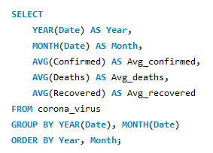
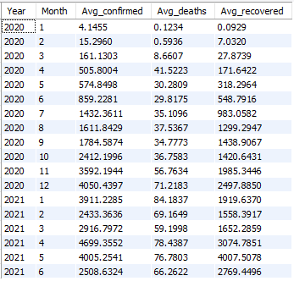
Monthly Average
Based on output, the average number of confirmed, deaths and recovered cases are
Confirmed : 4699 in April 2021
Death : 84 in January 2021
Recovered : 4007 in May 2021

Slide 13
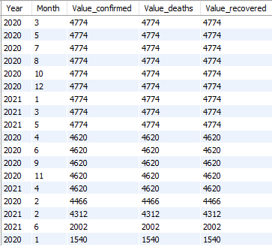
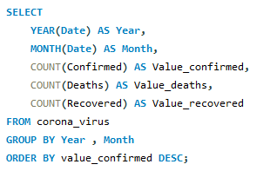
Most frequent value of confirmed, deaths and recovered

Slide 14
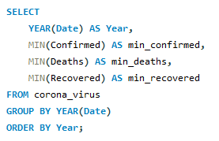

Minimum values for confirmed, deaths, recovered per year

Slide 15
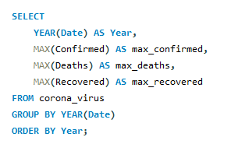

Maximum values for confirmed, deaths, recovered per year
Based on output, the maximum number of confirmed, deaths and recovered cases are
Confirmed : 823225 in 2020
Death : 7374 in 2021
Recovered : 1123456 in 2020

Slide 16
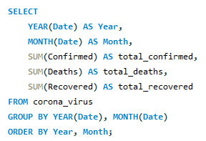
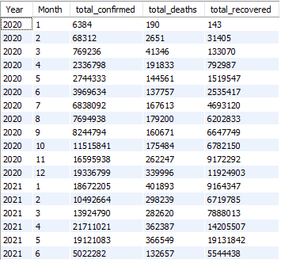
Total number of case of confirmed, deaths, recovered each month
The total number of confirmed cases was highest in April 2021, totally 21711021 cases.
The highest number of death cases was recorded in January 2021, count is 401893.
The highest number of recovered cases was in May 2021, totally 19131842.

Slide 17
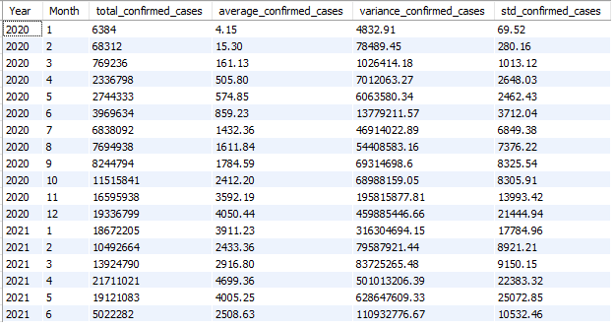
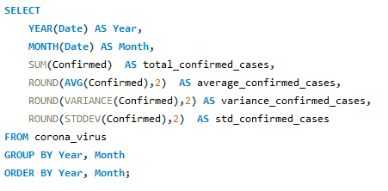
Checking how corona virus spread out with respect to confirmed case

Slide 18
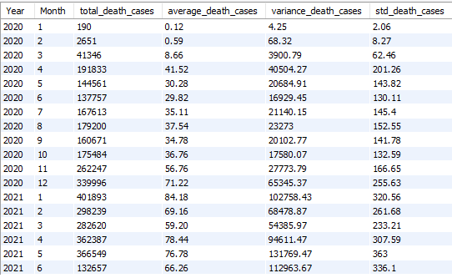
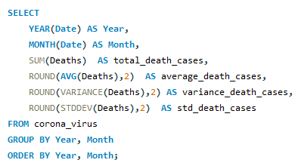
Checking how corona virus spread out with respect to death case

Slide 19
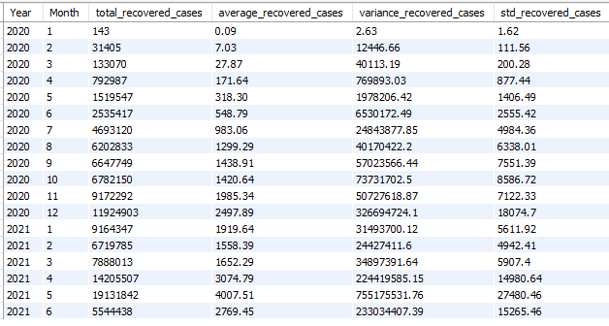
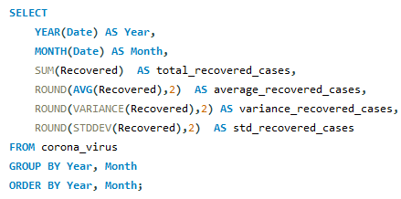
Checking how corona virus spread out with respect to recovered case

Slide 20
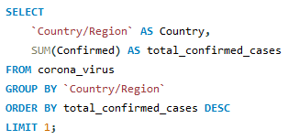
Country having highest number of the Confirmed case
US
Total Confirmed cases
33461982

Slide 21
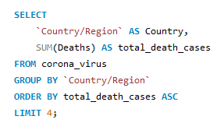

Country having lowest number of the death case
Inference : Dominica, Marshall Islands, Kribati and Samoa have least number of death case

Slide 22
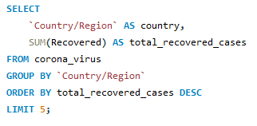
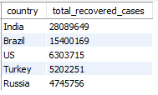
Top 5 Country having highest recovered cases
Inference : India has the highest number of recovered cases. Followed by Brazil, US, Turkey and Russia.

Slide 23
Conclusion
After analyzing the corona virus dataset, several insights were uncovered :
The pandemic started on January 22, 2020 and ended on June 13, 2021.
Highest confirmed cases was recorded in April,2021.
Highest death cases was recorded in January,2021.
India has the highest recovery cases.
US has the highest confirmed cases
Lowest death cases were recorded in Dominica, Kiribati, Marshall Islands and Samoa.

Slide 24
Thank You!!!

